Slide 1


Real Estate “Lands”
Shoug Al-Khathran
Amal Al-Shahabi
Instructor:
Mejdal Al-Qahtani

Slide 2
Contents
Contents | NO
Introduction | 1
Problem Statement | 2
EDA | 3
Regression | 4
Conclusion – Future Work | 5

Slide 3
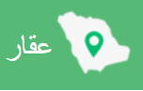
Introduction
Aqar Application Company seeks, as much as possible, to provide the information on its website with the utmost accuracy. However, some errors may occur from time to time. Aqar Application Company does not bear any responsibility for any error in the information contained in the site or application.
Aqar Trading Company is a 100% Saudi company with its head office located in Riyadh.
“Customer” is the individual, institution or company who accesses the site and benefits from its services directly or indirectly, whether by registration or without registration, and he is either a seller, buyer, lessor, or wants to rent, a real estate office, or a real estate marketer, and here represents the second party.

Slide 4
Problem Statement
Many people face the lack of a clear reference that measures land prices in Riyadh and predicts neighborhood prices in the future. On this basis, we made a model that predicts land prices based on area and neighborhood.

Slide 5
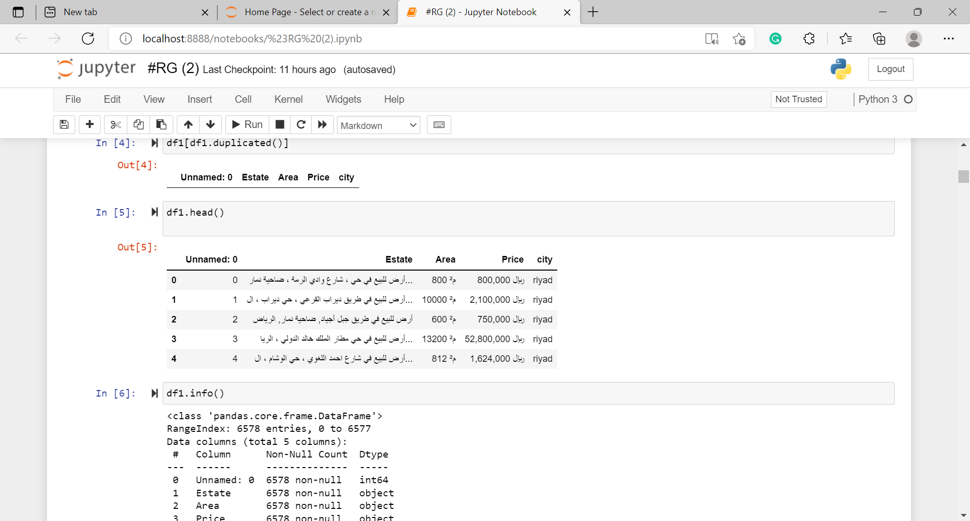
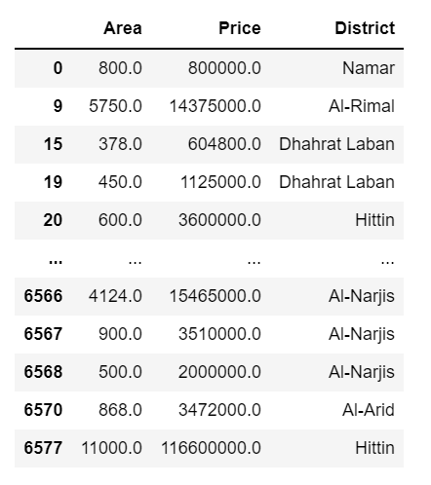
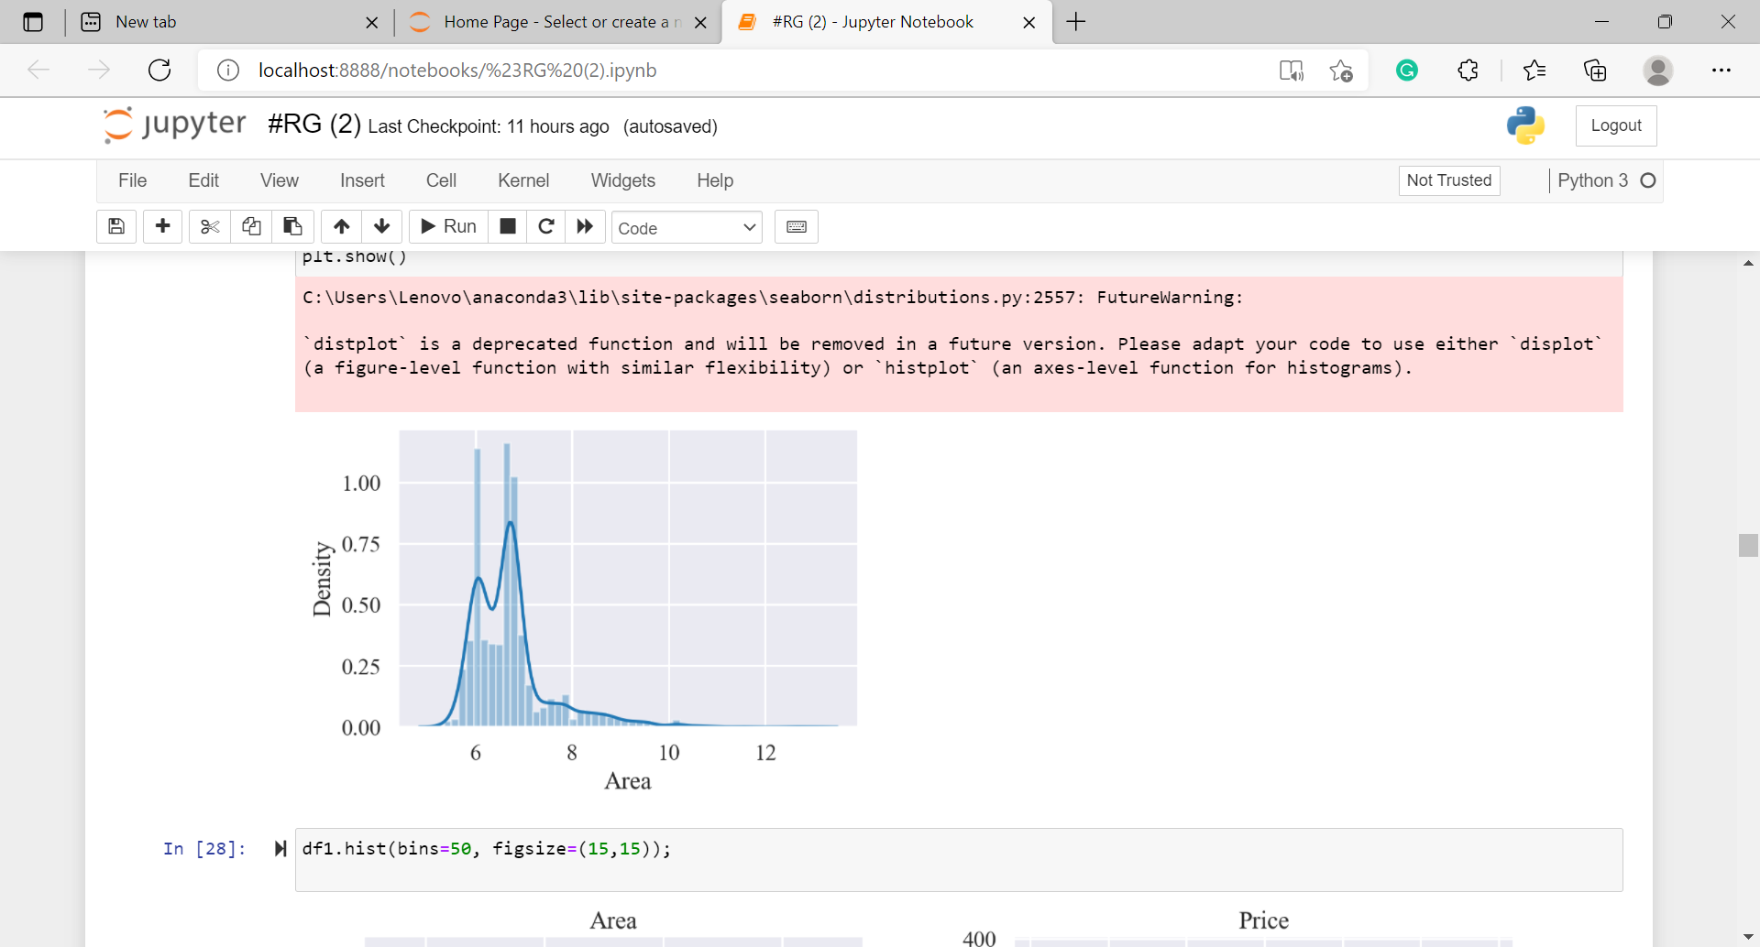
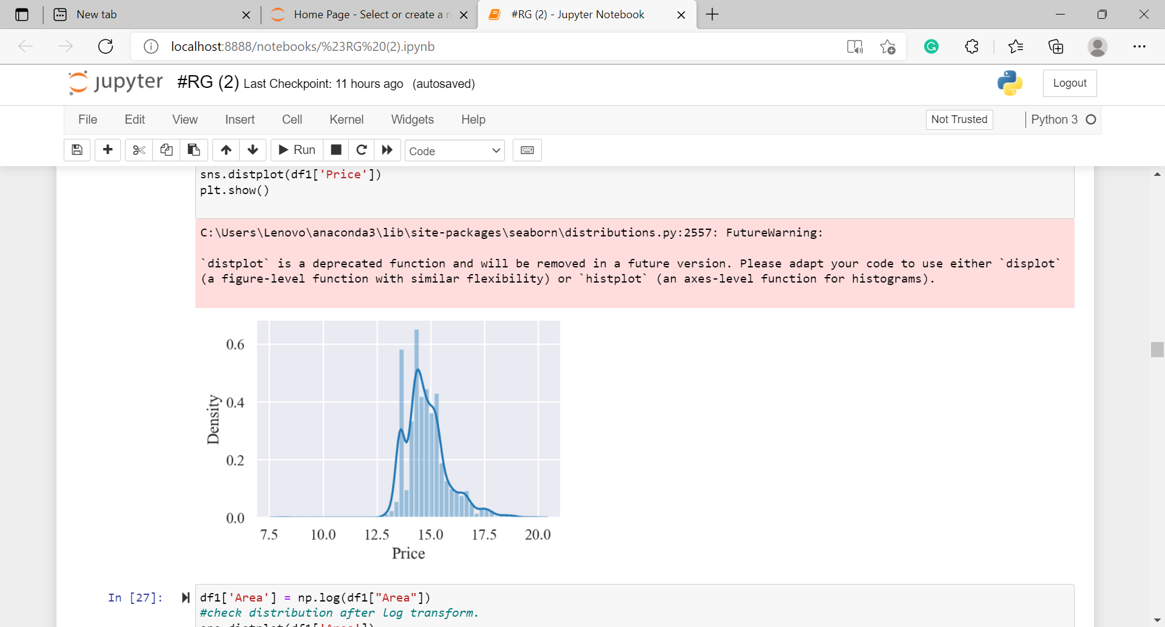
EDA and Clean data
-Remove duplicated values.
-Feature Engineering.
-Convert Datatype from Object into Float.

Slide 6
Problems
Is the existence of a suitable website for obtaining suitable data for the land property
When converting the district column by dummy is returned to Arabic
The problem is that the model does not understand the data because it is collected in one place
The problem is the lack of satisfactory results in the test data, unlike the Train results

Slide 7
Models
Linear Regression
Ridge Regression
LASSO Regression
Polynomial Regression
Random Forest Regressor

Slide 8
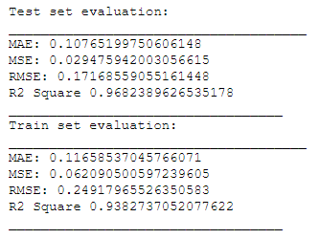
Linear Regression
• Model formula
Y = a + bX
The result

Slide 9

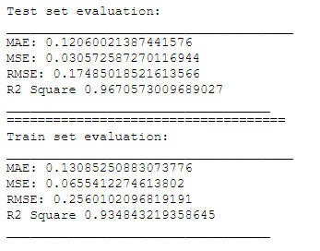
Ridge Regression
• Model formula
The result

Slide 10
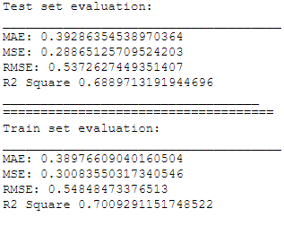
LASSO Regression
• Model formula
The result

Slide 11

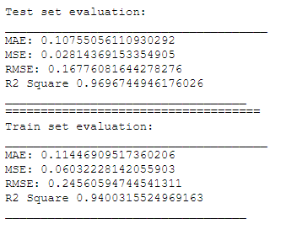
Polynomial Regression
• Model formula
The result

Slide 12
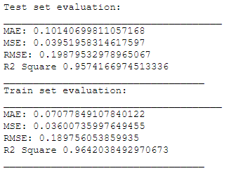
Random Forest Regressor
The result

Slide 13
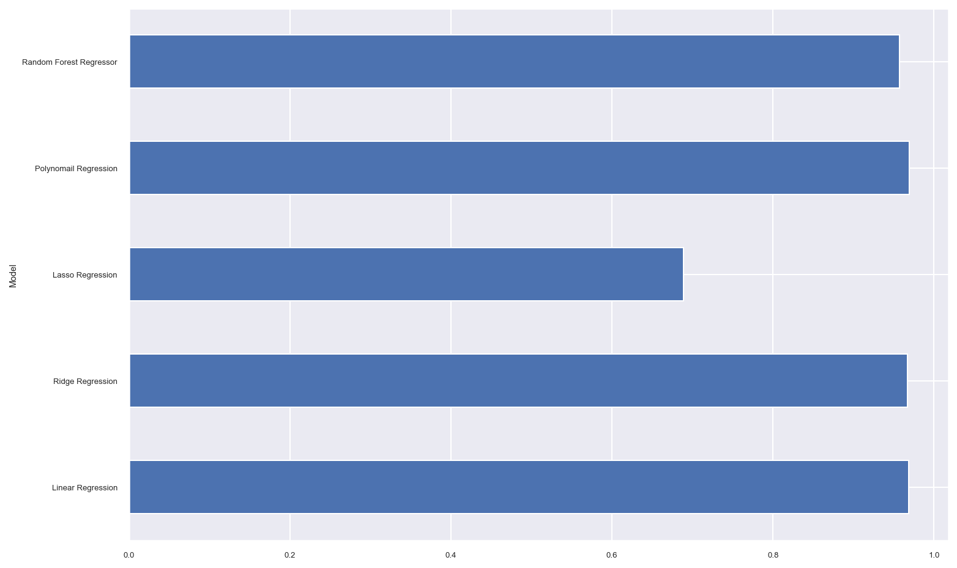
Model Comparison

Slide 14
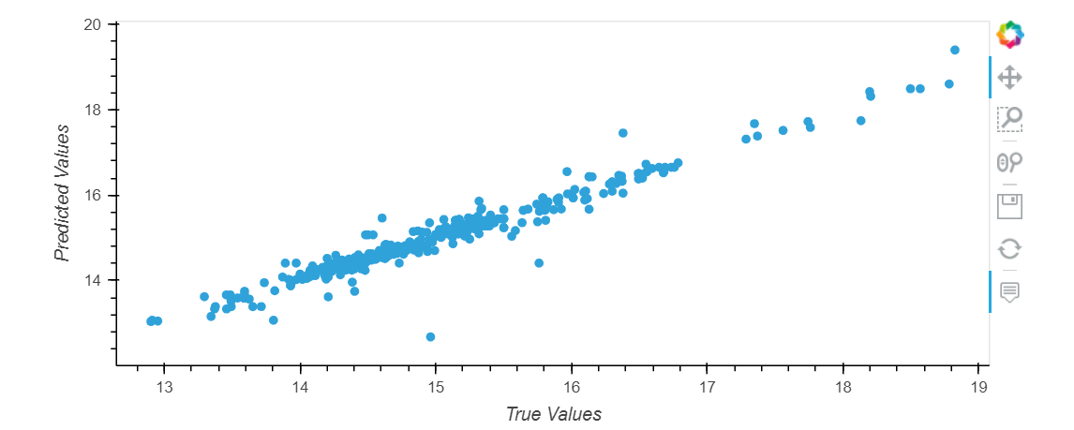
Predictions from our Model

Slide 15
Conclusion and Future-work
After the results of the model appeared and the comparison between the results of each model, we concluded that the best model is the highest R^2 model.
Future-work:
We seek to improve the accuracy of the model in the future by adding additional features such as (street width - facade - population in each neighborhood), which helps us in developing the project and determining Land prices according to specifications.

Slide 16
THANK YOU FOR LISTENING Any Question..! We not a real estate experts, please do not embarrass us.

